Slide 1

LinMemo
We are here to offer you a game to speed up your memory

Slide 2

Our game is distinct because
Our game is for anyone
You can use it at any moment
You can play with it in your spare time
It is simple.

Slide 3

LinMemo is based on scientific studies
These studies state that you do not need any
special level of concentration to increase you
memory

Slide 4
Some specs
Written in Java, play it anywhere.
It’s free under GPLv3 licence.
The game has different levels with more or less difficulty. You can choose any level.
The game has many levels and many pictures to remember.
It is portable, it is not necessary to have a specific operative system or software.

Slide 5
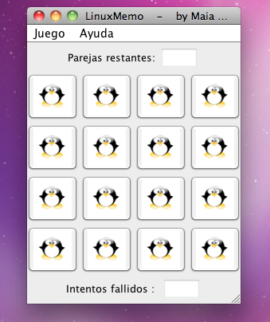
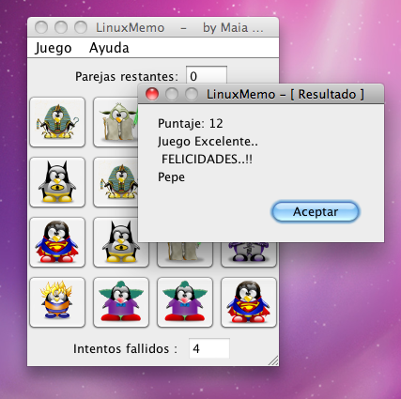
Screenshots

Slide 6
Why to use our game?
Because you will improve your memory while having fun.
It has been proven that as the days go by, you will begin to feel the progress. Your memory will become more flexible and you will remember more things.
What is more, you will not forget to do things.

Slide 7

What’s next ?
Let’s try it...

